Slide 1
The Bible
How did the Bible get put together?
Are we sure it is an accurate copy of the original?
Why were some books not included?
How the bible was formed

Slide 2
Views on the bible
“Fifty years after I die, the Bible will be obsolete.”
Thomas Paine (1737-1809)
“Another century and there will not be a Bible on earth!” Voltaire (1694- 1778)
“The Bible is no mere book, but is a living creature, with a power that conquers all that oppose it”
Napolen Bonaparte

Slide 3
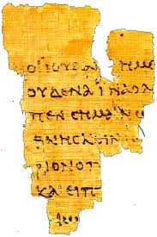
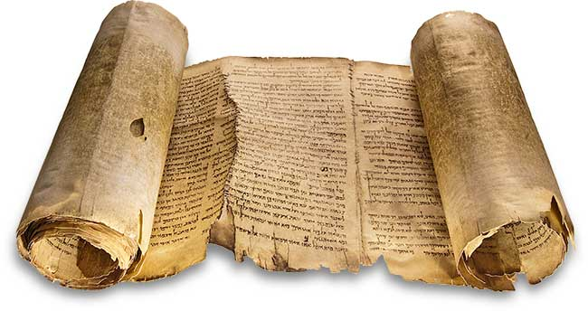
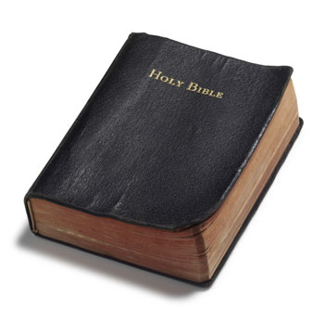
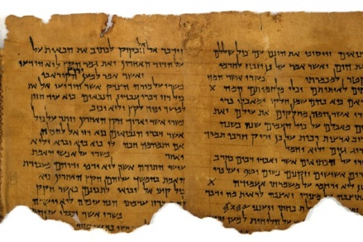
From scrolls to mobile apps
Papyrus
On-Line
Mobile
“But you Daniel, shut up the words and seal the book until the end of time. Many shall run to and fro and knowledge shall increase”
(Dan 12:4)
Scrolls & Codex
CD & Audio
Parchment
Codex ‘Book’

Slide 4
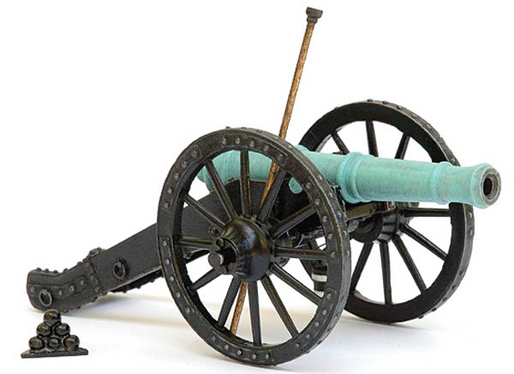
Question of the canon
Canon = ‘standard’
How were the books chosen to be in the Bible?
“a book is not the Word of God because it is accepted by the people of God. Rather, it was accepted by the people of God because it is the Word of God”
Josh McDowall

Slide 5
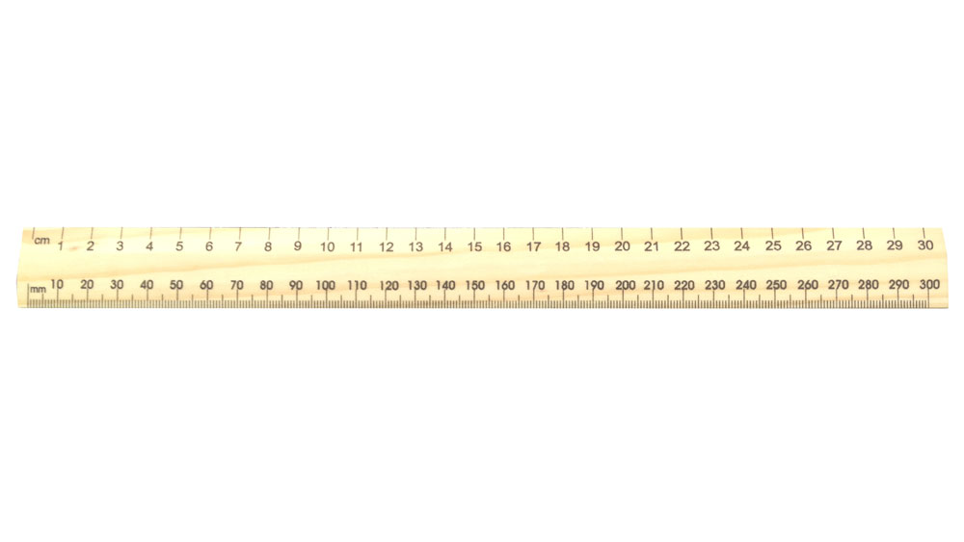
measure FOR CANONICITY
“a book is not the Word of God because it is accepted by the people of God. Rather, it was accepted by the people of God because it is the Word of God” (Josh McDowall)
Was the book written by a prophet or Apostle?
Was the writer confirmed by acts of God?
Did the message tell the truth about the God?
Did it come with the power of God (i.e. did the message have a transforming force for edification?)
Was it accepted by the people of God?

Slide 6
THE TANAKH
THE LAW “Torah” or “Pentateuch” | First Five books (Genesis-Deuteronomy)
THE PROPHETS “Navi” or “Nevi’im” | Joshua, Judges, 1 Samuel, 2 Samuel, 1 Kings, 2 Kings, Isaiah, Jeremiah, Ezekiel, Hosea, Joel, Amos, Obadiah, Jonah, Micah, Nahum, Habakkuk, Zephaniah, Haggai, Zechariah, Malachi
THE WRITINGS “Ketuvim” | Psalms, Proverbs, Job, Song of Songs, Ruth, Ecclesiastes, Esther, Daniel, Ezra, Nehemiah, 1 Chronicles, 2 Chronicles
285 BC - Tanakh translated into Greek by 72 Greek Scholars “the Septuagint”

Slide 7
OLD TESTAMENT CONFIRMED
“that all things must be fulfilled, which were written in the Law of Moses, and the Prophets, and the Psalms concerning me”
Luke 24:44
“Therefore this generation will be held responsible for the blood of all the prophets that has been shed since the beginning of the world, from the blood of Abel to the blood of Zechariah”
Luke 11:50-51
“Genesis was the first book in the Hebrew canon, and Chronicles the last. So Jesus was basically saying ‘from Genesis to Chronicles’, or, according to our order ‘from Genesis to Malachi’, thereby confirming the divine authority and inspiration of the entire Hebrew canon”
Josh McDowall
New Evidence that Demands a Verdict

Slide 8
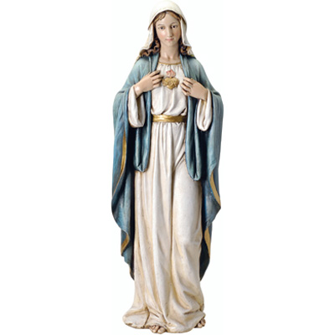
APOCRYPHA “HIDDEN”
AD 1545-63
Roman Catholic Church added books to the Old Testament:
Judith
Wisdom of Solomon
Tobit
Sirach (Ecclesiasticus)
Baruch
1 and 2 Maccabees,
Additions to the Jewish books of Esther and Daniel

Slide 9
APOCRYPHA
Reasons for exclusion
Excluded from Protestant and Hebrew Old Testament because:
Not accepted by Jesus
Contain historical and geographical inaccuracies
False doctrines, inconsistent with the Tanakh
Rejected by ancient historians and scholars (Josephus, Jewish Scholars of Jamnia)
Rejected by Jerome (translator of Latin Vulgate)
AD 1545-63
Roman Catholic Church added books to the Old Testament:
Judith
Wisdom of Solomon
Tobit
Sirach (Ecclesiasticus)
Baruch
1 and 2 Maccabees,
Additions to the Jewish books of Esther and Daniel

Slide 10
New testament canon
AD 367 Athanasius of Alexandria gave the earliest recorded list of New Testament books
List later confirmed by early church leaders (Polycarp, Clement of Alexandra)
393AD Church Council formally listed the 27 books as the New Testament
Apocrypha
Approximately 280 books excluded because:
Only locally recognized at best
Most were appendices to main books
No major church adopted them
Contained clear doctrinal errors
Recognition by Early believers
Early church collected letters from the Apostles
Apostles instructed churches to circulate them (2 Peter 3:15-16, Col 4:16, 1 Thes 5:27)
Peter recognized Paul’s writings as Scripture (2 Peter 3:16)
Compilation of new testament

Slide 11
Is the bible Authentic?
How do we know the books and the words are genuine?

Slide 12
How reliable is the bible?
Timeliness of the books
Number of copies
Record of the life of Jesus was written by people when eye witnesses were living. In comparison, accounts of Alexandra the Great were written 400 years after his death
Many passages assert the author was an eye witness (Luke 1:1-3, 2 Peter 1:16, 1 John 1:3)
“We can already say emphatically that there is no longer any solid basis for dating any book of the New Testament after about AD 80”
(William Albright, leading biblical archaeologist)
Book | Copies
New Testament | 5,000 complete Greek manuscripts 20,000 partial manuscripts
Homers Illiad | 643 partial manuscripts
“There is no body of ancient literature in the world which enjoys such a wealth of good textual attestation as the New Testament” (F.F. Bruce)

Slide 13
Dead sea scrolls
1947
Bedouin shepherd boy discovers cave with leather scrolls in jars
Other caves subsequently found
Approx 980 manuscripts
Scrolls dated back 1900 years to AD68
Comparison to earliest versions showed at most a 5% variation in the text
Variation was minor spelling errors

Slide 14
The bible inspired by god
“All Scripture is God breathed…”
2 Timothy 3:16
‘All’ | Greek word “Pas” which means – all, any, every, the whole, thoroughly, whatsoever, whosoever
‘Scripture’ | Greek word “Graphe” which means “a writing”. When a capital S is used in the word “Scripture” it means Holy writings
‘God breathed’ | Greek word “Theospneo”: Theos – God; neo – breathe hard, breeze
“Above all, you must understand that no prophecy of Scripture came about by the Prophet’s own interpretation. For prophecy never had its origin in the will of man, but men spoke from God as they were carried along by the Holy Spirit” 2 Peter 1:20

Slide 15
The bible inspired by god
The Holy Spirit’s role in writing the New Testament
The Gospels | Remind them of everything Jesus had said (John 14:26)
Acts to Jude | Teach them all things, and guide them into all truth (John 14:26; 16:12-13)
Revelation and Prophecy | Tell them what was yet to come (John 16:13)

Slide 16
Your challenge
“Do not let this Book of the Law depart from your mouth; meditate on it day and night, so that you may be careful to do everything written in it. Then you will be prosperous and successful”
Joshua 1:8
Your Plan
Choose a book of the Bible
Take ½ hour per week & write your own commentary on 5 verses
Tell someone what you are learning – at church, lifegroup, dinner table, cafe

Slide 17
The Bible
How did the Bible get put together?
Are we sure it is an accurate copy of the original?
Why were some books not included?
How the bible was formed

