Slide 1
The Bible
Revelation of god to man
Mark Rees-Thomas

Slide 2
View of the bible
2018 Barna Research Group
2011 Survey – Christian Colleges
Finding: 51% of Protestant Pastors have a biblical worldview
“… a belief in absolute moral truth as defined by scripture, as well as acceptance of six core biblical beliefs: the accuracy of biblical teaching, the sinless nature of Jesus, the literal existence of Satan, the omnipotence and omniscience of God, salvation by grace alone, and the personal responsibility to evangelize”
Of 200 Christian Colleges in America:
35% teach the Bible is True
25% teach it is ‘inspired of God’

Slide 3
Northern Hills survey
How do we view the Bible?

Slide 4
Northern hills survey
39 responses
Views of the bible
 | Yes
Have read the entire Bible | 62%
Have a personal Bible study plan | 62%
 | Yes
The Bible is inspired by God | 100%
The Bible is without error | 95%
The Bible should be interpreted in light of society’s values | 5%
How often we read the Bible
< 1 per week | 2-3 times/ wk | >3 times/ week
5% | 23% | 72%
Engagement with the bible

Slide 5
Northern hills survey
Do you believe the following is true?
 | Yes
Jesus died and rose | 100%
Everlasting Hell | 100%
Everlasting Heaven | 100%
Satan will rule earth through the Antichrist | 97%
Jesus will reign on earth for 1000 years | 95%
People in other religions will go to Heaven if sincere about seeking God | 13%
What the bible claims
Do you believe the following is true?
 | Yes
7 day creation | 92%
Adam and Eve as first humans | 97%
Real Devil | 100%
Worldwide flood | 92%
All miracles in the Bible | 100%
Mary was the virgin mother of Jesus | 100%
Jesus is God in the flesh | 100%
What the bible claims

Slide 6
Survey summary
Strong belief in Bible reliability and how we should address current society issues
Personal engagement with the Bible is good but needs to be better
Strong belief in taking the Bible at face value in both creation, early biblical events and Bible prophecy
Some uncertainty about where salvation through Christ sits with other religions

Slide 7
Series introduction
Revelation of God to man
How the Bible was formed
How the Bible proves itself
Standing on the Bible
The Bible in 40 minutes
How to study the Bible

Slide 8
The Bible
revelation of god to man

Slide 9
Without excuse

Slide 10
Definitions
Revelation the disclosure of what was previously unknown
General Revelation Disclosure of evidence to everyone that God exists and something of what he is like
Special Revelation Informs us that we are separated from God, and that he calls us freely into relationship with him through his Son Jesus Christ

Slide 11
External general revelation

Slide 12
External general revelation
“The Heavens declare the glory of God; the skies proclaim the work of his hands. Day after day they pour forth speech; night after night they display knowledge. There is no speech or language where their voice is not heard. Their voice goes out into all the earth, their words to the ends of the world.”
Psalm 19:1-4

Slide 13
External general revelation
“The Heavens declare the glory of God; the skies proclaim the work of his hands. Day after day they pour forth speech; night after night they display knowledge. There is no speech or language where their voice is not heard. Their voice goes out into all the earth, their words to the ends of the world.”
Location and language are no barrier to the General Revelation of God.
The Heavens have a ‘voice’.
Whoever looks at creation has to actively suppress the message
The message is not hidden

Slide 14
Evidence of the creator
Mathematical Consistency
“…mathematicians aren’t making up what they do… The mathematician’s task isn’t to event it – he can’t – but to discover it and describe it for our benefit and God’s glory”
“There is no way that the atheist can account for the fact that the physical world, the mind, and mathematics, make such a perfect fit together”
David Anderson

Slide 15
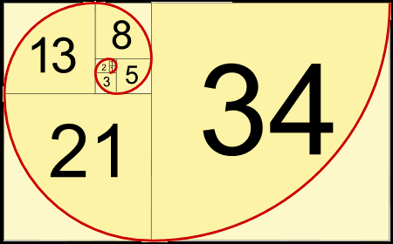
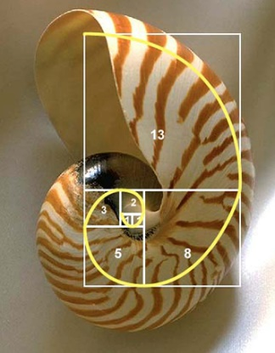
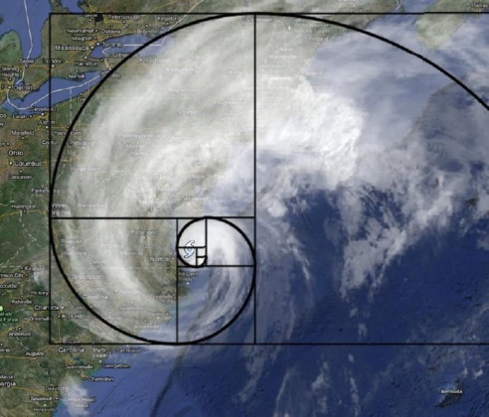
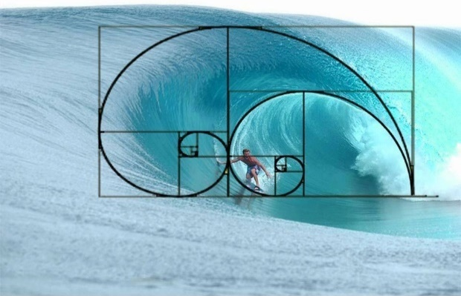
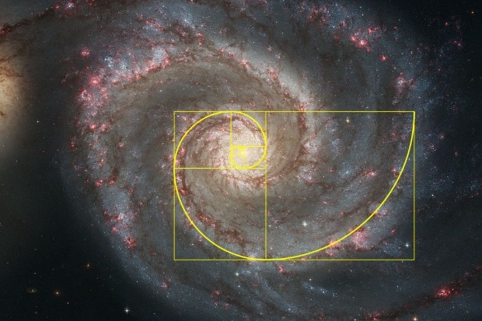
Evidence of the creator
Fibonacci Sequence
0, 1, 1, 2, 3, 5, 8, 13, 21, 34, 55, 89

Slide 16
External general revelation
“The wrath of God is being revealed from heaven against all the godlessness and wickedness of men who suppress the truth by their wickedness, since what may be known about God is plain to them, because God has made it plain to them. For since the creation of the world God’s invisible qualities – his eternal power and divine nature – have been clearly seen, being understood from what has been made, so that men are without excuse.”
Romans 1:19-20

Slide 17
internal general revelation
“Indeed when Gentiles, who do not have the law, do by nature things required by the law, they are a law for themselves, even though they do not have the law. They show that the requirements of the law are written on their hearts, their consciences also bearing witness, and their thoughts sometimes accusing them and at other times even defending them.”
Romans 2:14-15
“He has also set eternity in the human heart, yet no one can fathom what God has done from beginning to end”
Ecclesiastes 3:11

Slide 18
Internal general revelation
“The Fool says in his heart ‘there is no God’”
Psalm 14:1
“Even wicked men are forced, by the mere view of the earth and sky, to rise to the Creator”
John Calvin
“One does not automatically stand in awe of God’s creation and then in doing so know of God’s will, of sin and of pardon”
Professor Van Til

Slide 19
Special revelation
“…he [Jesus] does not so much make a revelation of God, as himself is the revelation of God; He does not merely disclose God’s purpose of redemption, He is unto us wisdom from God, and righteousness and sanctification and redemption. The theophanies are but faint shadows in comparison with his manifestation of God in the flesh.”
Benjamin Warfield

Slide 20
Special revelation
“In the beginning was the Word, and the Word was with God, and the Word was God. He was with God in the beginning. Through him all things were made; without him nothing was made that has been made. In him was the life, and that life was the light of men…The Word became flesh and made his dwelling among us”
John 1:1-3, 14
“In the past God spoke to our forefathers through the prophets at many times and in various ways, but in these last days he has spoken to us by his Son, whom he appointed heir of all things, and through whom he made the universe. The Son is the radiance of God’s glory and the exact representation of his being, sustaining all things by his powerful word.”
Hebrews 1:1-3

Slide 21
Types of special revelation
Theophany
Christophany
Internal suggestion (from God)
Co-operative (carried along)

Slide 22
theophany
God’s presence
examples
“God blessed them and said to them…” (Gen 1:28)
“Then the man and his wife heard the sound of the Lord God as he was walking in the garden in the cool of the day…” (Gen 3:8)
In a flame in the burning bush (Exodus 2:2-6)
Through fire and smoke on Mount Sinai (Exodus 19:18-20)
In a still small voice to Elijah (1 King 19:12)
In a voice in the night to young Samuel (1 Samuel 3:6)
A voice from heaven at the Baptism of Jesus (Matthew 3:17)

Slide 23
christophany
“The Word became flesh and made his dwelling among us.”
(John 1:14)
“No one has ever seen God, but God the one and only who is at the Father’s side has made him known”
(John 1:18)

Slide 24
christophany
Hagar said to the Angel of the Lord “You are the God who sees me”
Genesis 16:11-13
Having seen the Angel of the Lord, Manoah cried “We are doomed to die!’ he said to his wife. ‘We have seen God!’”
Judges 13:3,6-22
God appeared to Abraham as a man
Genesis 18:1-2
Jacob wrestled with a man and declared “It is because I saw God face to face and yet my life was spared.”
Genesis 32:24-30

Slide 25
Internal suggestion
“When a prophet of the Lord is among you, I reveal myself to him in visions, I speak to him in dreams…”
Numbers 12:6
dreams
visions
Jacob’s dream at Bethel (Genesis 28:10-12)
Joseph’s dreams of ruling over his family (Genesis 37:5,9)
The Baker and the cup bearer (Genesis 40:5)
Pharoah’s dreams of famine (Genesis 41)
Nebuchadnezzar’s dream of end times (Daniel 2)
Daniel’s vision of end times (Daniel 8-12)
Ezekiel’s vision of God (Ezekiel 1)
Isaiah’s visions (book of Isaiah)
John’s vision of end times (book of Revelation)

Slide 26
Co-operative special revelation
“All Scripture is God breathed…”
2 Timothy 3:16
‘All’ | Greek word “Pas” which means – all, any, every, the whole, thoroughly, whatsoever, whosoever
‘Scripture’ | Greek word “Graphe” which means “a writing”. When a capital S is used in the word “Scripture” it means Holy writings
‘God breathed’ | Greek word “Theospneo”: Theos – God; neo – breathe hard, breeze

Slide 27
The Bible
Revelation of god to man
Mark Rees-Thomas

